Slide 1
Missing Data
Nicholas Mattei, Tulane University
CMPS3660 – Introduction to Data Science – Fall 2019
https://rebrand.ly/TUDataScience
Many Thanks
Slides based off Introduction to Data Science from John P. Dickerson - https://cmsc320.github.io/

Slide 2
Announcements
Peer Observation Tuesday 10/29
Finish Lab 7
Review Questions
Today’s Lecture
https://xkcd.com/979/

Slide 3
The Data LifeCycle
Data Collection
Data Processing
Exploratory Analysis
&
Data Visualization
Analysis, Hypothesis Testing,
& ML
Insight
&
Policy Decision
Today
Today

Slide 4
Today’s Lecture
Missing Data …
What is it?
Simple methods for imputation.
… with a tiny taste of Stats/ML lecturers to come.
Thanks to John Atwood and Wenjiang Fu

Slide 5
Missing Data
Missing data is information that we want to know, but don’t!
It can come in many forms, e.g.:
People not answering questions on surveys
Inaccurate recordings of the height of plants that need to be discarded
Canceled runs in a driving experiment due to rain
Could also consider missing columns (no collection at all) to be missing data …
[JA]

Slide 6
Key Question
Why is the data missing?
What mechanism is it that contributes to, or is associated with, the probability of a data point being absent?
Can it be explained by our observed data or not?
The answers drastically affect what we can ultimately do to compensate for the missing-ness
[JA]

Slide 7
Complete Case Analysis
Delete all tuples with any missing values at all, so you are left only with observations with all variables observed
Default behavior for libraries for analysis (e.g., regression).
We’ll talk about this much more during the Stats/ML lectures
This is the simplest way to handle missing data. In some cases, will work fine; in others, ?????????????:
Loss of sample will lead to variance larger than reflected by the size of your data.
May bias your sample.
# Clean out rows with nil values
df = df.dropna()
[JA]

Slide 8
Example
Dataset: Body fat percentage in men, and the circumference of various body parts [Penrose et al., 1985]
Question: Does the circumference of certain body parts predict body fat percentage?
Given complete data, how would you answer this ?????????
One way to answer is regression analysis:
One or more independent variables ("predictors”)
One dependent variables (“outcome”)
What is the relationship between the predictors and the outcome?
What is the conditional expectation of the dependent variable given fixed values for the independent variables?
Generalized body composition prediction equation for men using simple measurement techniques", K.W. Penrose, A.G. Nelson, A.G. Fisher, FACSM, Human Performance research Center, Brigham Young University, Provo, Utah 84602 as listed in Medicine and Science in Sports and Exercise, vol. 17, no. 2, April 1985, p. 189.
http://staff.pubhealth.ku.dk/~tag/Teaching/share/data/Bodyfat.html

Slide 9
A Side Note On Terms
For linear regression we have equations of where we want to know the relationship between an outcome given some predictors.
If you have a ML background:
Get target, outcome given predictors, observations.
If you have a Stats background:
Get endogenous variables given exogenous variables.
If you are more of a Math person:
Get dependent variable (y-axis) given one or more independent variables (x-axis).

Slide 10
Linear Regression
Assumption: relationship between variables is linear:
(We’ll relax linearity, study in more depth later.)
Population Y-Intercept
Population Slope
Random Error
Y
=
β
+
β
X
+
ε
i
0
1
i
i
Dependent Variable (e.g., ????????)
Independent Variable(s) (e.g., ?????????)
[WF]

Slide 11
Population & Sample Regression Models
Population
☺
☺
☺
☺
☺
[WF]
Notes:
31

Slide 12
Population & Sample Regression Models
Population
Unknown Relationship
☺
☺
☺
☺
☺
[WF]
Notes:
32

Slide 13
Population & Sample Regression Models
Population
Random Sample
Unknown Relationship
☺
☺
☺
☺
☺
☺
☺
[WF]
Notes:
33

Slide 14
Population & Sample Regression Models
Population
Random Sample
Unknown Relationship
☺
☺
☺
☺
☺
☺
☺
[WF]
Notes:
34

Slide 15
Linear Regression
Observedvalue
ε_{i} = Random error
Observed value
[WF]
Notes:
35

Slide 16
Sample Linear Regression Model
ε_{i} = Random error
^
Unsampled observation
Observed value
[WF]
Notes:
36

Slide 17
Estimating Parameters: Least Squares Method
?
Notes:
40

Slide 18
Scatter Plot
Plot all (X_{i}, Y_{i}) pairs, and plot your learned model
If you squint, suggests how well the model fits the data
Y
60
40
20
0
X
0
20
40
60
[WF]

Slide 19
Question
How would you draw a line through the points?
How do you determine which line “fits the best” …? ?????????
Y
60
40
20
0
X
0
20
40
60
[WF]
Notes:
42

Slide 20
Question
How would you draw a line through the points?
How do you determine which line “fits the best” ?????????
Slope changed
Y
60
40
20
0
X
0
20
40
60
Intercept unchanged
[WF]
Notes:
43

Slide 21
Question
How would you draw a line through the points?
How do you determine which line “fits the best” ?????????
Slope unchanged
Y
60
40
20
0
X
0
20
40
60
Intercept changed
[WF]
Notes:
44

Slide 22
Question
How would you draw a line through the points?
How do you determine which line “fits the best” ?????????
Slope changed
Y
60
40
20
0
X
0
20
40
60
Intercept changed
[WF]
Notes:
45

Slide 23
Least Squares
Best Fit: difference between the true Y-values and the estimated Y-values is minimized:
Positive errors offset negative errors …
… square the error!
Least squares minimizes the sum of the squared errors
Why squared? We’ll cover this in more depth in a few weeks.
Until then: http://www.benkuhn.net/squared
[WF]
Notes:
51

Slide 24
Least Squares, Graphically
[WF]
Notes:
52

Slide 25
Announcements
Prof. Daniele is here!
Questions 6 Fixed
Milestone 1 Decompress (Updated Project 2) – Professionalism.
Lab Thursday – Be here with Laptop – new setup!
More Missing Data!
https://xkcd.com/979/

Slide 26
Interpretation of Coefficients
^
Slope (β₁):
Estimated Y changes by β₁ for each unit increase in X.
If β₁ = 2, then Y Is expected to increase by 2 for each 1 unit increase in X.
Y-Intercept (β₀):
Average value of Y when X = 0.
If β₀ = 4, then average Y is expected to be 4 when X Is 0.
^
^
^
^
In-depth analysis to come!
For an in depth derivation in matrix form:
https://www.stat.cmu.edu/~cshalizi/mreg/15/lectures/13/lecture-13.pdf
[WF]

Slide 27
Now, Back to Missing Data …

Slide 28
Example
Question: Does the circumference of certain body parts predict BF%?
Assumption: BF% is a linear function of measurements of various body parts and other features …
Analysis: Results from a regression model with BF% …
(Interpretation ???????????)
Predictor | Estimate | S.E. | p-value
Age | 0.0626 | 0.0313 | 0.0463
Neck | -0.4728 | 0.2294 | 0.0403
Forearm | 0.45315 | 0.1979 | 0.0229
Wrist | -1.6181 | 0.5323 | 0.0026
If you want to jump ahead on stats:
http://rpubs.com/nicholas_dirienzo/linear_regression_fall2019
[JA]
Notes:
Standard error – estimate of the standard deviation, will talk about this more later …
The p-value is the probability of obtaining a result equal to or "more extreme" than what was actually observed, when the null hyp is actually true – we’ll talk about this more …

Slide 29
Hypothesis Testing
One of the core ideas of Data Science – Should be at the core of all the analysis that you do.
Define a test statistic - a quantity (numerical summary of a data-set that reduces the data to one value) derived from the sample used to test a hypothesis.
The Null Hypothesis: H0 = The feature of interest has no effect on the target.
The Alternative Hypothesis: H1 = The feature of interest does have an effect on the target.
You’re testing if H0 is true or not. If it is, then you say there’s no relationship between our features. If it’s not, then you say ‘we reject H0 and accept H1’ – i.e., the features are related!
This gets into some tricky logic that statisticians argue over as you actually aren’t testing H1, but we’re going to avoid that discussion here. Book Link (On Webpage): Introduction to Statistical Learning http://faculty.marshall.usc.edu/gareth-james/ISL/

Slide 30
P-values
A p-value is is the probability of obtaining a result equal to or "more extreme" than what was actually observed, when the null hypothesis is actually true.
Null Hypothesis: There is no significant difference between the specified populations. The observed difference is due to sampling or experiment error.
Typically, when we have a p-value below a certain threshold, say 0.05, then we can reject the null hypothesis and say that there is an effect.

Slide 31
What If Data Were Missing?
In this case, the dataset is complete:
But what if 5 percent of the participants had missing values? 10 percent? 20 percent?
What if we performed complete case analysis and removed those who had missing values?
Let’s examine the effect if we do this if when the data is missing completely at random (MCAR)
Removed cases at random, reran analysis, stored the p-values
p-value: probability of getting at least as extreme a result as what we observed given that there is no relationship
Repeat 1000 times, plot p-values of the hypothesis test on slope=0 (why?).
[JA]

Slide 32
Population & Sample Regression Models
Population
Random Sample
Unknown Relationship
☺
☺
☺
☺
☺
☺
☺
[WF]
Notes:
34

Slide 33
The Bootstrap
What happens if we only have one sample? Why might we need more?
All that we have is the original sample.
… which is large and random.
Therefore, it probably resembles the population.
So we sample at random from the original sample!
We’ll dive more into this later but it’s a powerful tool – can be used to calculate values you might not otherwise be able to estimate.

Slide 34
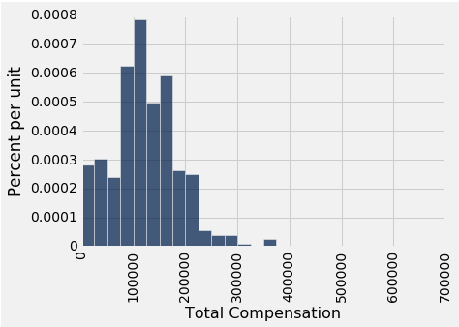
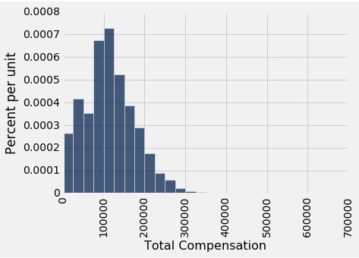
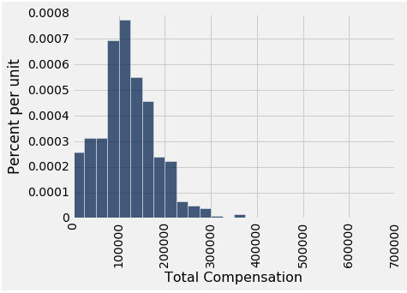
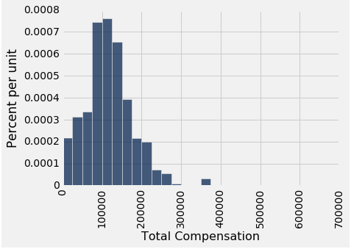
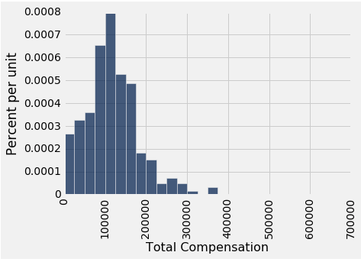
Why The Bootstrap Works
population
sample
resamples
All of these look similar… most likely…

Slide 35
Why We Need The Bootstrap
population
sample
resamples
What we wish we could get
What we really get

Slide 36
Key to Resampling
Random Sample
From the original sample,
draw at random
with replacement
as many values as the original sample contained
The size of the new sample has to be the same as the original one, so that the two estimates are comparable.
Population
☺
☺
Unknown Relationship
☺
X A LOT
☺
☺
☺
☺
☺
☺
Bootstrap Sample

Slide 37
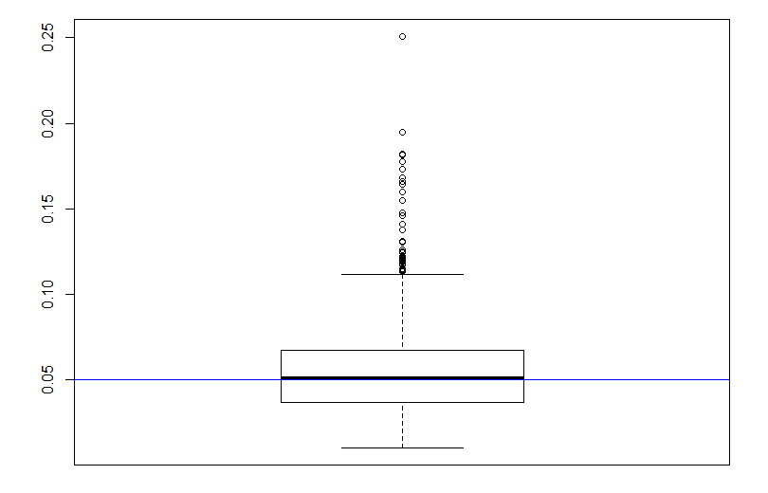
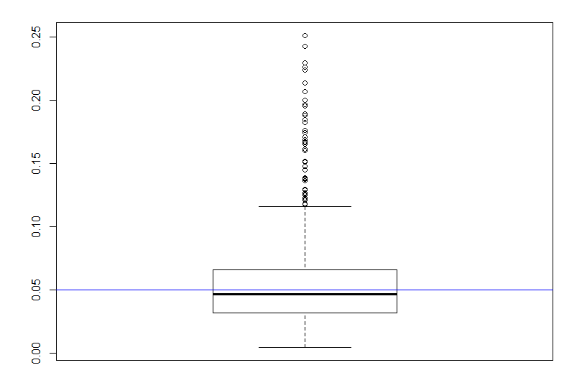
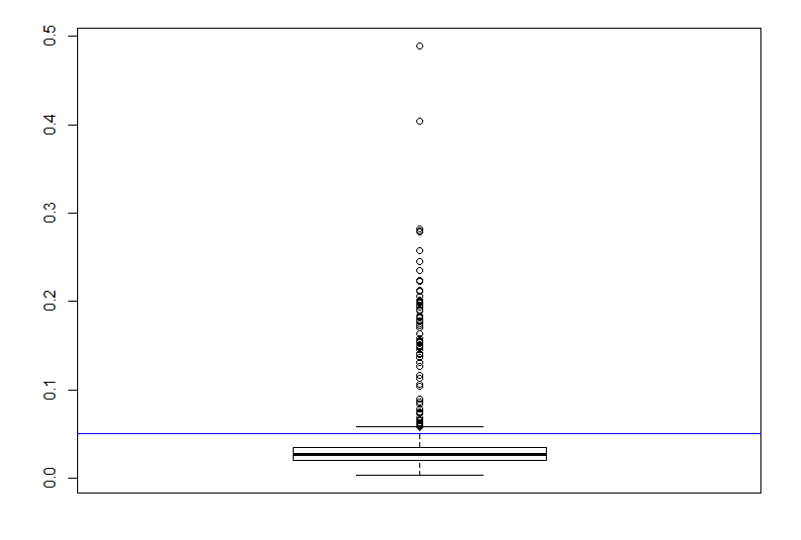
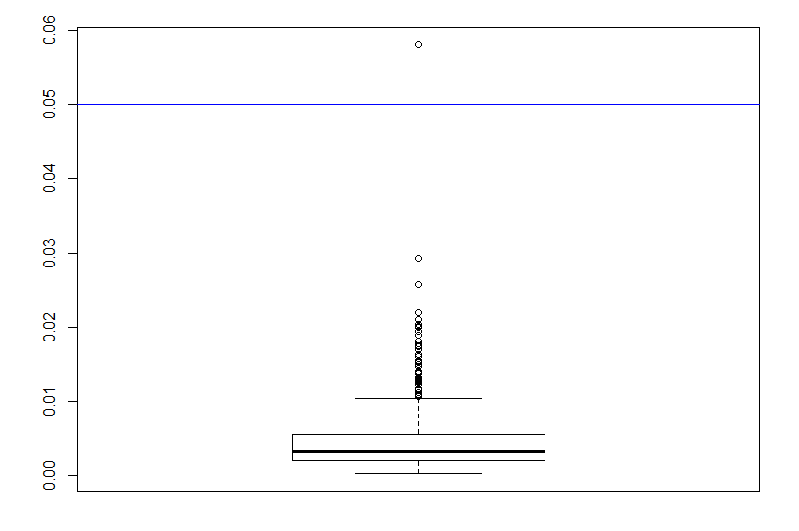
~5% Deleted (N=13)
p-value
Neck
Forearm
Wrist
Age
[JA]

Slide 38
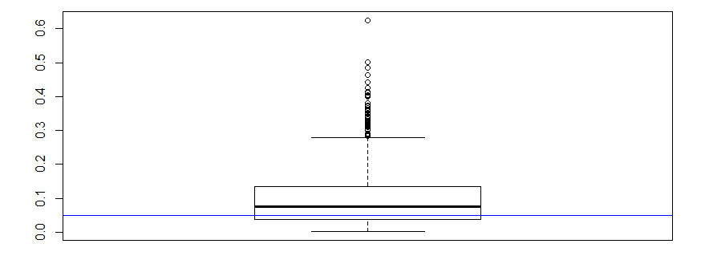
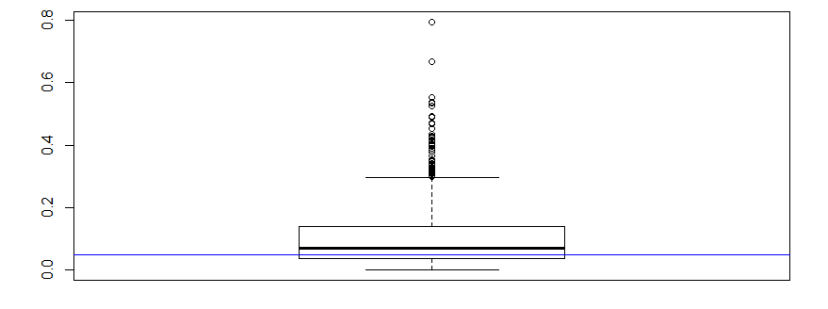
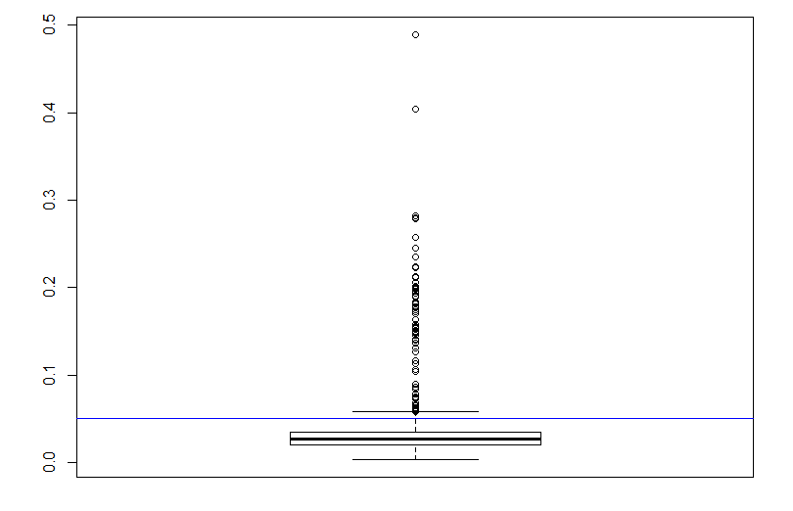
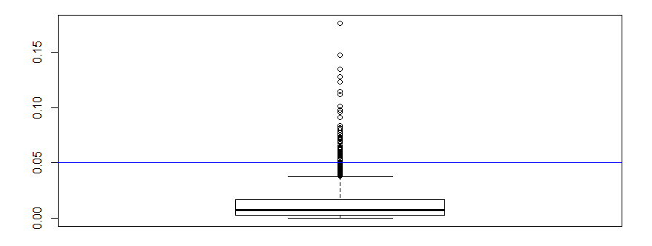
~20% Deleted (N=50)
p-value
Age
Neck
Forearm
Wrist
[JA]

Slide 39
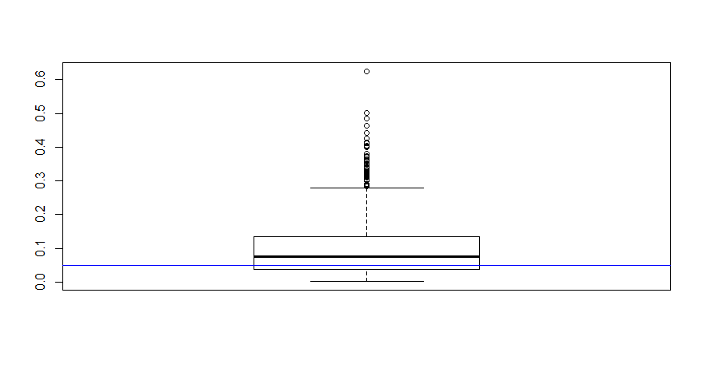
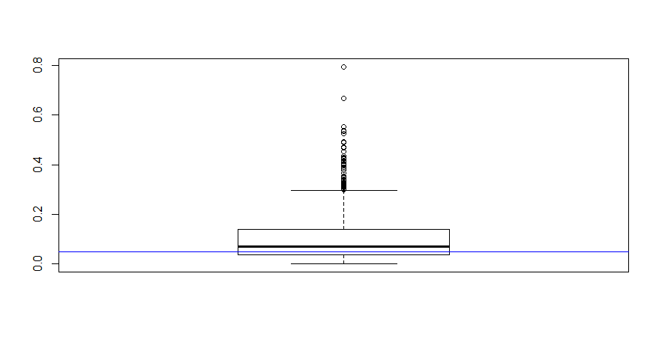
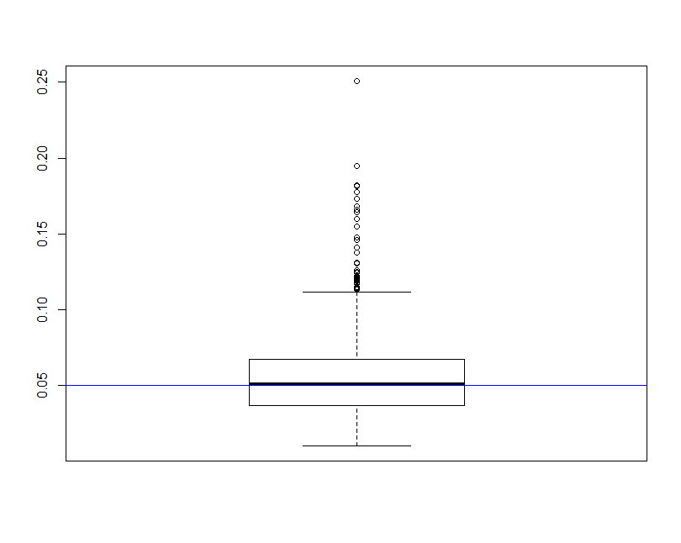
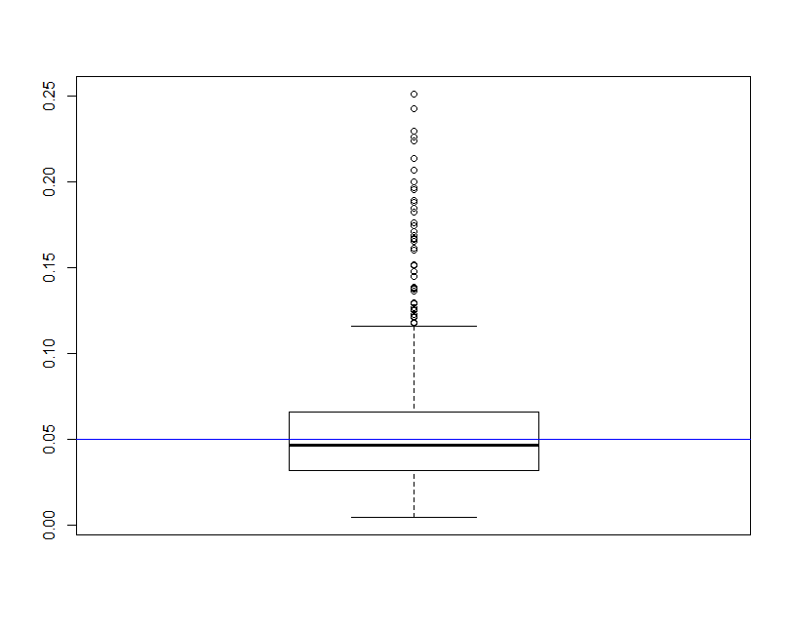
Conclusions seem to change …
Age/Neck: fail to reject the null hypothesis usually?
vs
Age (5%)
Neck (5%)
Age (20%)
Neck (20%)
Still reject Forearm/Wrist most of the time
This is assuming the missing subjects’ distribution does not differ from the non-missing. This would cause bias …
[JA]

Slide 40
Types Of Missing-ness
Missing Completely at Random (MCAR)
Missing at Random (MAR)
Missing Not at Random (MNAR)
[JA]

Slide 41
What Distinguishes Each Type of Missing-ness?
Suppose you’re loitering outside of STH one day …
Students just received their mid-semester grades
You start asking passing students their CMPS3660 grades
You don’t force them to tell you or anything
You also write down their gender and hair color
[JA]

Slide 42
Your Sample
Hair Color | Gender | Grade
Red | M | A
Brown | F | A
Black | F | B
Black | M | A
Brown | M
Brown | M
Brown | F
Black | M | B
Black | M | B
Brown | F | A
Black | F
Brown | F | C
Red | M
Red | F | A
Brown | M | A
Black | M | A
Summary:
7 students received As
3 students received Bs
1 student received a C
Nobody is failing!
But 5 students did not reveal their grade …
[JA]

Slide 43
What Influences a Data Point’s Presence?
Same dataset, but the values are replaced with a “0” if the data point is observed and “1” if it is not
Question: for any one of these data points, what is the probability that the point is equal to “1” …?
P(R) i.e., the probability that we didn’t see it.
What type of missing-ness do the grades exhibit?
Hair Color | Gender | Grade
0 | 0 | 0
0 | 0 | 0
0 | 0 | 0
0 | 0 | 0
0 | 0 | 1
0 | 0 | 1
0 | 0 | 1
0 | 0 | 0
0 | 0 | 0
0 | 0 | 0
0 | 0 | 1
0 | 0 | 0
0 | 0 | 1
0 | 0 | 0
0 | 0 | 0
0 | 0 | 0
[JA]

Slide 44
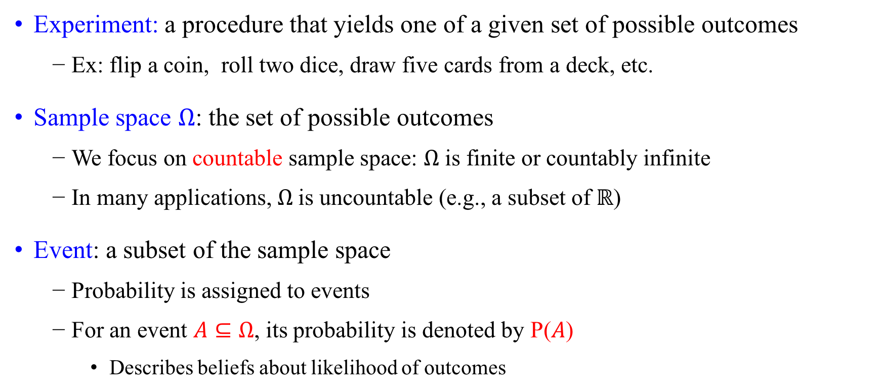
Experiment and Sample Space
Experiment: a procedure that yields one of a given set of possible outcomes
Ex: flip a coin, roll two dice, draw five cards from a deck, etc.
Sample space $Ω$: the set of possible outcomes
We focus on countable sample space: $Ω$ is finite or countably infinite
In many applications, $Ω$is uncountable (e.g., a subset of $ℝ$)
Event: a subset of the sample space
Probability is assigned to events
For an event $A⊆Ω$, its probability is denoted by P($A$)
Describes beliefs about likelihood of outcomes
Notes:
Flip a coin: two outcomes {head, tail}, Roll a 6-sided dice: six outcomes {1, 2, 3, 4, 5, 6}, Draw a card from a standard 52-card deck: 52 outcomes
What is sample space when rolling two dices?
Flip a fair coin until you get a head

Slide 45
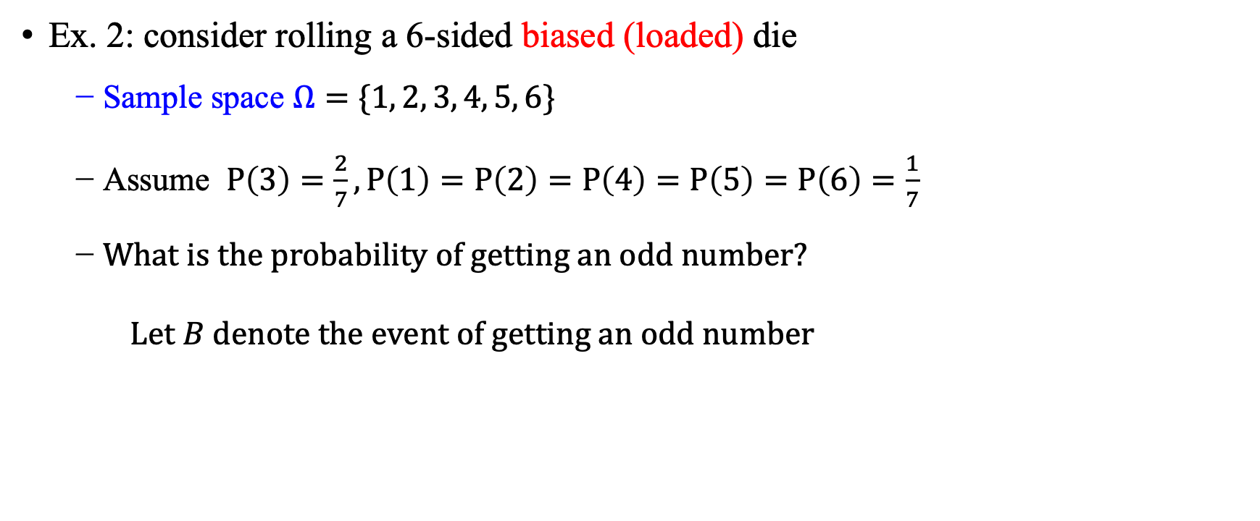
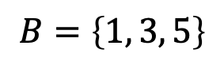
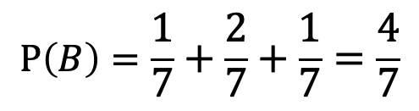
Examples
Ex. 2: consider rolling a 6-sided biased (loaded) die
Sample space $Ω=\{1, 2, 3, 4, 5, 6\}$
Assume $P\left(3\right)=\frac{2}{7}, P\left(1\right)=P\left(2\right)=P\left(4\right)=P\left(5\right)=P\left(6\right)=\frac{1}{7}$
What is the probability of getting an odd number?
Let $B$ denote the event of getting an odd number
$$B=\left\{1, 3, 5\right\}$$
$$P\left(B\right)=\frac{1}{7}+\frac{2}{7}+\frac{1}{7}=\frac{4}{7}$$
Notes:
Ex. 3: Find the probability that a hand of five cards in poker contains four cards of one kind.

Slide 46
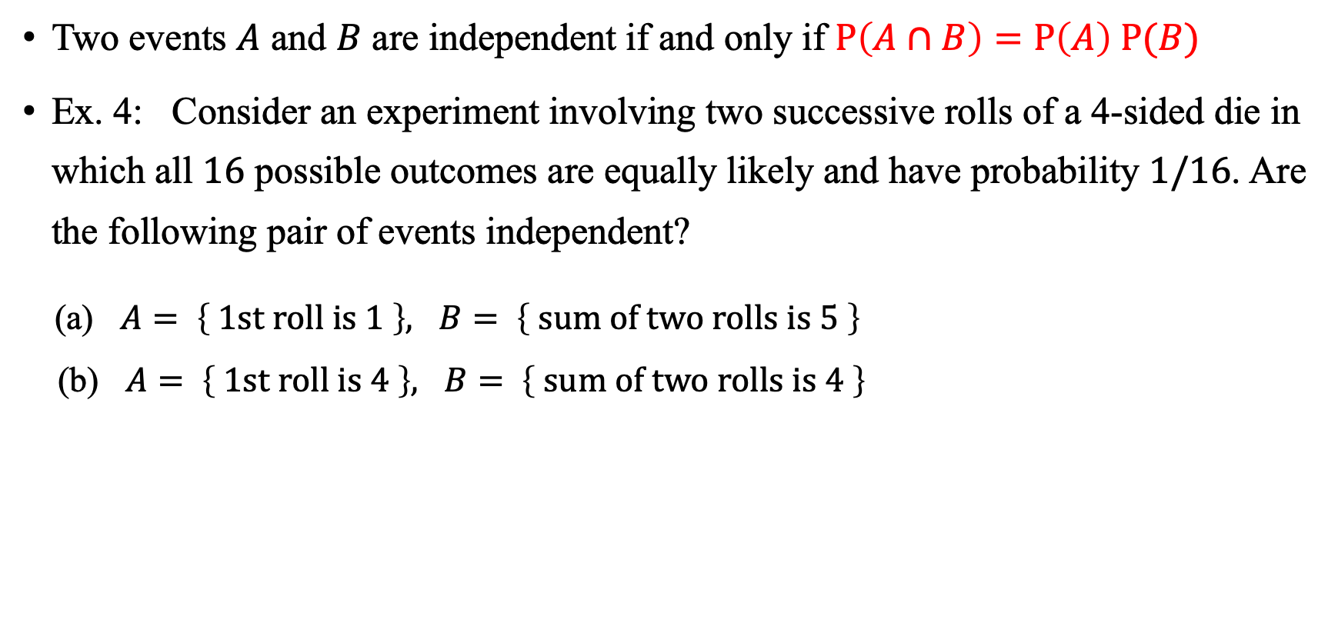
Independence
Two events $A$ and $B$ are independent if and only if $P\left(A∩B\right)=P\left(A\right) P(B)$
Ex. 4: Consider an experiment involving two successive rolls of a 4-sided die in which all $16$ possible outcomes are equally likely and have probability $1/16$. Are the following pair of events independent?
(a) $A= \left\{ 1st roll is 1 \right\}, B= \left\{ sum of two rolls is 5 \right\}$
(b) $A= \left\{ 1st roll is 4 \right\}, B= \left\{ sum of two rolls is 4 \right\}$
Yes
No
Notes:
Careful, the second one is tricky!

Slide 47
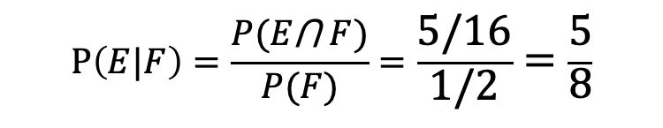
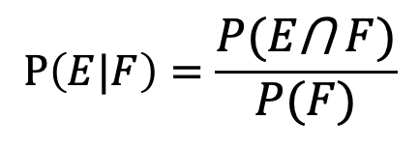
Conditional Probability
Definition: Let E and F be events with P(F) > 0. The conditional probability of E given F, denoted by P(E|F), is defined as:
Example: A bit string of length four is generated at random so that each of the 16 bit strings of length 4 is equally likely. What is the probability that it contains at least two consecutive 0s, given that its first bit is a 0?
Solution: Let E be the event that the bit string contains at least two consecutive 0s, and Let F be the event that the first bit is a 0.
Since E ⋂ F = {0000, 0001, 0010, 0011, 0100}, P(E⋂F) = 5/16.
Because 8 bit strings of length 4 start with a 0, P(F) = 8/16 = ½.
Hence,
$$P\left(E|F\right)=\frac{P(E\text{⋂} F)}{P(F)}$$
$$P\left(E|F\right)=\frac{P(E\text{⋂} F)}{P(F)}=\frac{5/16}{1/2}=\frac{5}{8}$$

Slide 48
Announcements / Order of the Day
Questions 7 Review
Questions 8 Change of Plans!
Office Hours / Grad Students
Rest of Missing Data
Lab Time! (Due Date?)
https://xkcd.com/557/

Slide 49
MCAR: Missing Completely at Random
Hair Color | Gender | Grade
0 | 0 | 0
0 | 0 | 0
0 | 0 | 0
0 | 0 | 0
0 | 0 | 1
0 | 0 | 1
0 | 0 | 1
0 | 0 | 0
0 | 0 | 0
0 | 0 | 0
0 | 0 | 1
0 | 0 | 0
0 | 0 | 1
0 | 0 | 0
0 | 0 | 0
0 | 0 | 0
If this probability is not dependent on any of the data, observed or unobserved, then the data is Missing Completely at Random (MCAR).
Suppose that X is the observed data (hair and gender) and Y is the unobserved data (grade).
Call our “missing matrix” R.
Then, if the data are MCAR, P(R|X,Y) = ??????????
P(R|X,Y) = P(R)
Probability of those rows missing is independent of the observed and unobserved data.
I.e., the probability of that any given datapoint is missing is equal over the whole dataset. Each datum that is present had the same probability of being missing as each datum that is absent. Implies that ignoring the missing data will not bias inference.
[JA]

Slide 50
Totally Realistic MCAR Example
You are running an experiment on plants grown in pots, when suddenly you have a nervous breakdown working on Project 1 and smash some of the pots
You will probably not choose the plants to smash in a well-defined pattern, such as height age, etc.
Hence, the missing values generated from your act of madness will likely fall into the MCAR category
[JA]

Slide 51
Applicability of MCAR
A completely random mechanism for generating missing-ness in your data set just isn’t very realistic
Usually, missing data is missing for a reason:
Maybe older people are less likely to answer web-delivered questions on surveys.
In longitudinal studies people may die before they have completed the entire study.
Companies may be reluctant to reveal financial information.

Slide 52
MAR: Missing at Random
Hair Color | Gender | Grade
0 | 0 | 0
0 | 0 | 0
0 | 0 | 0
0 | 0 | 0
0 | 0 | 1
0 | 0 | 1
0 | 0 | 1
0 | 0 | 0
0 | 0 | 0
0 | 0 | 0
0 | 0 | 1
0 | 0 | 0
0 | 0 | 1
0 | 0 | 0
0 | 0 | 0
0 | 0 | 0
Missing at Random (MAR): probability of missing data is dependent on the observed data but not the unobserved data.
Suppose that X is the observed data and Y is the unobserved data. Call our “missing matrix” R.
Then, if the data are MAR, P(R|X,Y) = ??????????
P(R|X,Y) = P(R|X)
Not exactly random (in the vernacular sense).
There is a probabilistic mechanism that is associated with whether the data is missing.
Mechanism takes the observed data as input.
Notes:
MAR allows for data to be missing according to a random process, but is more general than MCAR in that all units do not have equal probabilities of being missing. The constraint here is that missingness may only depend on information that is fully observed. For example, the reporting of income on surveys may vary according to some measured factor, such as age, race or sex. We can thus account for heterogeneity in the probability of reporting income by controlling for the measured covariate in whatever model is used for infrence.

Slide 53
Examples?
?
MAR allows for data to be missing according to a random process that is fully observed!
more general than MCAR -- all units do not have equal probabilities of being missing.
E.g., reporting of income may vary according to some measured factor, such as age, race or sex.
Can account for heterogeneity in the probability of reporting by controlling for the measured covariate in some model.
Notes:
If we had a table of heights and weights…
If we know people with low grades are less likely to tell us their grade.

Slide 54
MAR: Key Point
Hair Color | Gender | Grade
0 | 0 | 0
0 | 0 | 0
0 | 0 | 0
0 | 0 | 0
0 | 0 | 1
0 | 0 | 1
0 | 0 | 1
0 | 0 | 0
0 | 0 | 0
0 | 0 | 0
0 | 0 | 1
0 | 0 | 0
0 | 0 | 1
0 | 0 | 0
0 | 0 | 0
0 | 0 | 0
We can model that latent mechanism and compensate for it!
Imputation: replacing missing data with substituted values.
Models today will assume MAR.
Example: if age is known, you can model missing-ness as a function of age.
Whether or not missing data is MAR or the next type, Missing Not at Random (MNAR), is not* testable.
Requires you to “understand” your data!
*unless you can get the missing data (e.g., post-study phone calls).
Notes:
When the probability of missing data varies according to information that is not available, this is classified as MNAR. This can either be because suitable covariates for explaining missingness have not been recorded (or are otherwise unavailable) or the probability of being missing depends on the value of the missing datum itself. Extending the previous example, if the probability of reporting income varied according to income itself, this is missing not at random.

Slide 55
MNAR: Missing Not at Random
MNAR: missing-ness has something to do with the missing data itself!
Examples: ??????????
Do you binge drink? Do you have a trust fund? Do you use illegal drugs? What is your sexuality? Are you depressed?
Said to be “non-ignorable”:
Missing data mechanism must be considered as you deal with the missing data.
Must include model for why the data are missing, and best guesses as to what the data might be.

Slide 56
Back to STH …
Is the the missing data:
MCAR;
MAR; or
MNAR?
???????????
Hair Color | Gender | Grade
Red | M | A
Brown | F | A
Black | F | B
Black | M | A
Brown | M
Brown | M
Brown | F
Black | M | B
Black | M | B
Brown | F | A
Black | F
Brown | F | C
Red | M
Red | F | A
Brown | M | A
Black | M | A

Slide 57
Add a Variable
Hair Color | GPA | Gender | Grade
Red | 3.4 | M | A
Brown | 3.6 | F | A
Black | 3.7 | F | B
Black | 3.9 | M | A
Brown | 2.5 | M
Brown | 3.2 | M
Brown | 3.0 | F
Black | 2.9 | M | B
Black | 3.3 | M | B
Brown | 4.0 | F | A
Black | 3.65 | F
Brown | 3.4 | F | C
Red | 2.2 | M
Red | 3.8 | F | A
Brown | 3.8 | M | A
Black | 3.67 | M | A
Bring in the GPA:
Does this change anything?

Slide 58
To Recap
Hair Color | GPA | Gender | Grade
Red | 3.4 | M | A
Brown | 3.6 | F | A
Black | 3.7 | F | B
Black | 3.9 | M | A
Brown | 2.5 | M
Brown | 3.2 | M
Brown | 3.0 | F
Black | 2.9 | M | B
Black | 3.3 | M | B
Brown | 4.0 | F | A
Black | 3.65 | F
Brown | 3.4 | F | C
Red | 2.2 | M
Red | 3.8 | F | A
Brown | 3.8 | M | A
Black | 3.67 | M | A
Assume that we have a matrix where X is the observed data, Y is the unobserved data, and R is Call our “missing matrix” R.
Missing Completely at Random (MCAR).
Missingness does not depend on observed or unobserved data.
P(R|X,Y) = P(R)
Missing at Random (MAR).
Missingness depends only on observed data.
P(R|X,Y) = P(R|X)
Missing Not At Random (MNAR).
Neither MCAR or MAR.

Slide 59
Handling Missing Data …

Slide 60
Single Imputation
Mean Imputation: imputing the average from observed cases for all missing values of a variable.
Hot-deck Imputation: imputing a value from another subject, or “donor,” that is most like the subject in terms of observed variables.
Last observation carried forward (LOCF): order the dataset somehow and then fill in a missing value with its neighbor.
E.g., In evaluations of interventions where pre-treatment measures of the outcome variable are also recorded, a strategy that is sometimes used is to replace missing outcome values with the pre-treatment measure.
Cold-deck Imputation: bring in other datasets.
Old and Busted:
All fundamentally impose too much precision.
Have uncertainty over what unobserved values actually are.
Developed before cheap computation.

Slide 61
Multiple Imputation
s₁
a₁
Developed to deal with noise during imputation!
Impute once → treats imputed value as observed.
We have uncertainty over what the observed value would have been
Multiple Imputation: generate several random values for each missing data point during imputation and pool the results!
Incomplete data
s₂
a₂
Pooled results
s_{N}
a_{N}
Impute N times
Analysis performed on each imputed set

Slide 62
Tiny Example
X | Y
32 | 2
43 | ?
56 | 6
25 | ?
84 | 5
Independent variable: X
Dependent variable: Y
We assume Y has a linear relationship with X

Slide 63
Let’s Impute Some Data!
Use a predictive distribution of the missing values (how??):
Given the observed values, make random draws of the observed values and fill them in.
Do this N times and make N imputed datasets.
X | Y
32 | 2
43 | 5.5
56 | 6
25 | 8
84 | 5
X | Y
32 | 2
43 | 7.2
56 | 6
25 | 1.1
84 | 5
For very large values of N=2 …

Slide 64
Inference with Multiple Imputation
Now that we have our imputed data sets, how do we make use of them? ???????????
Analyze each of the separately.
X | Y
32 | 2
43 | 5.5
56 | 6
25 | 8
84 | 5
X | Y
32 | 2
43 | 7.2
56 | 6
25 | 1.1
84 | 5
Slope | -0.8245
Standard error | 6.1845
Slope | 4.932
Standard error | 4.287
Y
=
β
+
β
X
+
ε
Y
=
β
+
β
X
+
ε
i
0
1
i
i
i
0
1
i
i

Slide 65
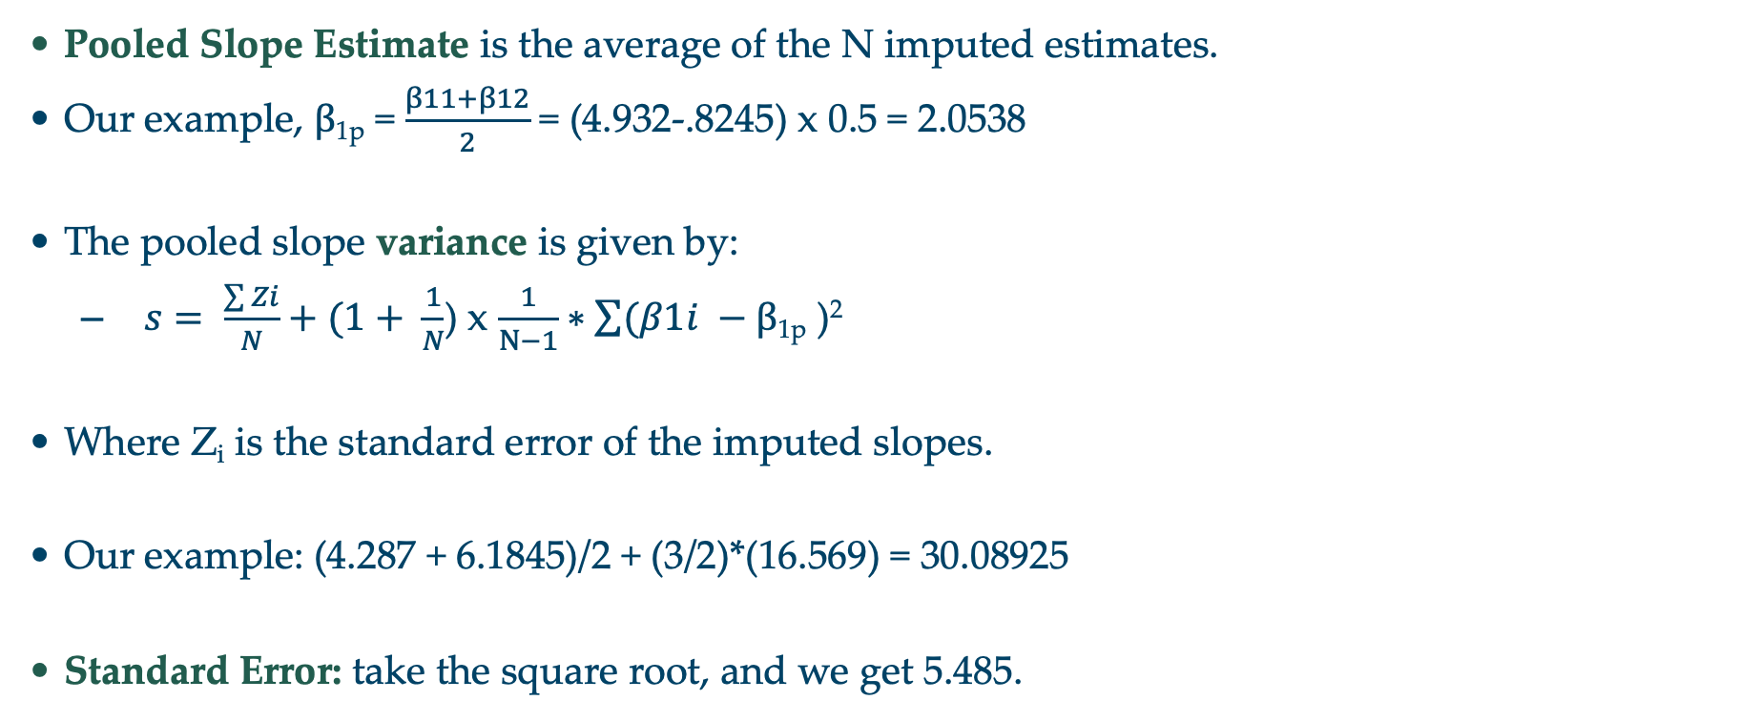
Pooling analyses
Pooled Slope Estimate is the average of the N imputed estimates.
Our example, β_{1p} = $\frac{β11+β12}{2}$ = (4.932-.8245) x 0.5 = 2.0538
The pooled slope variance is given by:
$s= \frac{\sum{Zi}}{N}+(1+ \frac{1}{N}$) x $\frac{1}{N−1}∗\sum{(β1i }−$ β_{1p} )²
Where Z_{i} is the standard error of the imputed slopes.
Our example: (4.287 + 6.1845)/2 + (3/2)*(16.569) = 30.08925
Standard Error: take the square root, and we get 5.485.
Notes:
For those following from home:
Variance: roughly how much a set of numbers are “spread around” their mean
Standard deviation: similar to variance (square root of variance) – same units as main data
Standard error (of the sample mean): how far the sample mean is from the population mean

Slide 66
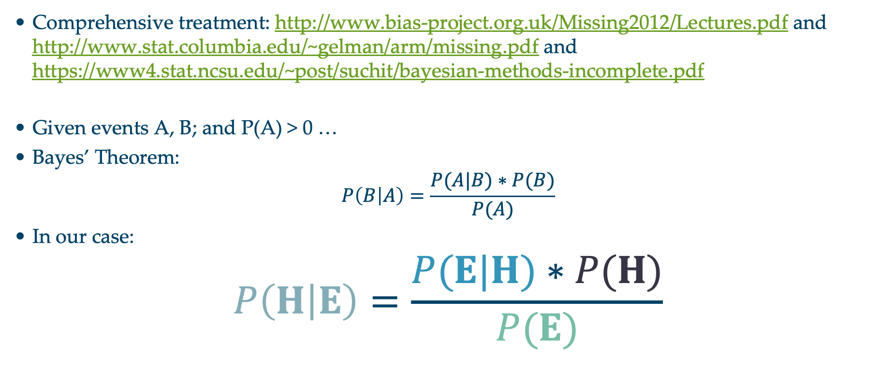
Predicting Missing Data Given the Observed Data
Comprehensive treatment: http://www.bias-project.org.uk/Missing2012/Lectures.pdf and http://www.stat.columbia.edu/~gelman/arm/missing.pdf and https://www4.stat.ncsu.edu/~post/suchit/bayesian-methods-incomplete.pdf
Given events A, B; and P(A) > 0 …
Bayes’ Theorem:
$$P\left(B | A\right)=\frac{P(A|B)∗P(B)}{P(A)}$$
In our case:
$$P\left(H | E\right)=\frac{P(E|H)∗P(H)}{P(E)}$$
Probability of seeing evidence given the hypothesis
Prior probability of hypotheses
Posterior probability of the hypothesis given the evidence
Prior over the evidence

Slide 67
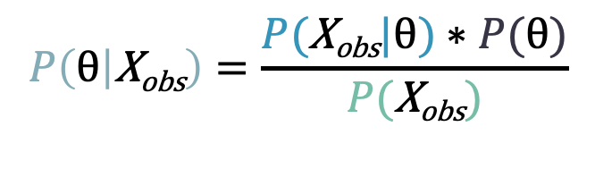
Bayesian Imputation
Establish a prior distribution:
Some distribution of parameters of interest θ before considering the data, P(θ).
We want to estimate θ.
Given θ, can establish a distribution P(X_{obs}|θ)
Use Bayes Theorem to establish P(θ|X_{obs}) …
Make random draws for θ.
Use these draws to make predictions of Y_{miss.}
$$P\left(\text{θ} | \text{X}\text{obs}\right)=\frac{P(\text{X}\text{obs}|\text{θ})∗P(\text{θ})}{P(\text{X}\text{obs})}$$

Slide 68
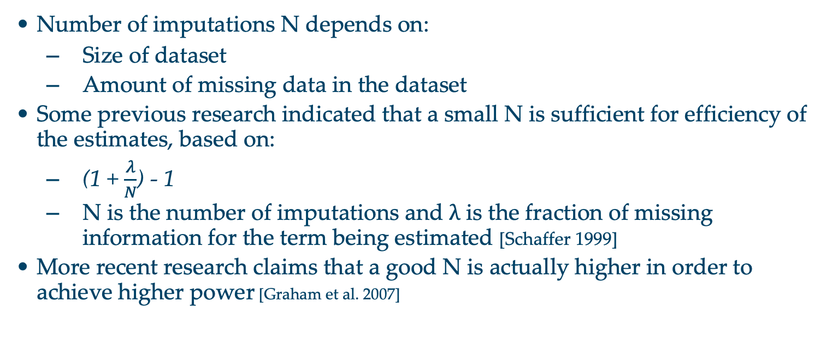
How Big Should N Be?
Number of imputations N depends on:
Size of dataset
Amount of missing data in the dataset
Some previous research indicated that a small N is sufficient for efficiency of the estimates, based on:
(1 + $\frac{λ}{N}$) - 1
N is the number of imputations and λ is the fraction of missing information for the term being estimated [Schaffer 1999]
More recent research claims that a good N is actually higher in order to achieve higher power [Graham et al. 2007]

Slide 69
More Advanced Methods
Interested? Further reading:
Regression-based MI methods
Multiple Imputation Chained Equations (MICE) or Fully Conditional Specification (FCS)
Readable summary from JHU School of Public Health: https://www.ncbi.nlm.nih.gov/pmc/articles/PMC3074241/
Markov Chain Monte Carlo (MCMC)
A bit more complicated - http://stronginference.com/missing-data-imputation.html
Comprehensive Tutorials (Grad level Stats):
http://www.bias-project.org.uk/Missing2012/Lectures.pdf
http://www.stat.columbia.edu/~gelman/arm/missing.pdf
https://www4.stat.ncsu.edu/~post/suchit/bayesian-methods-incomplete.pdf

